Slide 1

Wireless Power Transfer
C1C Henry
C1C Hermanson
C1C Pak
C1C Singh
1

Slide 2
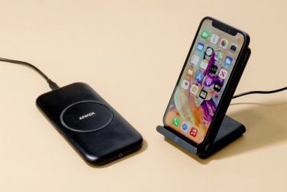
Executive Summary
Review fundamentals of WPT and associated vulnerabilities
Action items researched and completed
Significant developments and existing challenges
Next phase of research
Long-term implications and goals of research

Slide 3
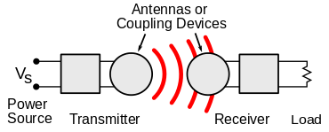
Technical Discussion
WPT is wireless point to point transmission protocol of electrical energy
Many implementations but Qi is the industry standard
Alternatives: AirFuel, Proprietary Near Field Magnetic Coupling, RF, Ultrasound
Delivers a variable amount of voltage to device depending on power requirements
New technology that lacks security capabilities and has vulnerabilities
Malicious messages can be sent between transmitter and receiver to alter power transmission
Messages between transmitter and receiver can be observed to gain information about receiver

Slide 4
Qi Specs
AC frequency in the primary coil
110 and 205 kHz for the “low power” Qi chargers (up to 5 W)
80 and 300 kHz (up to 120 W) for the “medium power” chargers
Optimized to operate from a 5V USB power supply
Uses “smart power limiting” to adjust the output power automatically to compensate for power-limited supplies

Slide 5
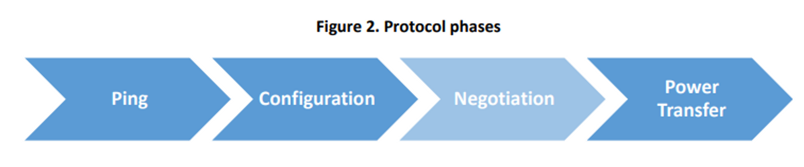
Qi – Protocol Overview
Ping Phase
The Power Transmitter tries to establish communications with a Power Receiver.
Configuration Phase
Power Receiver sends basic identification and configuration data to the Power Transmitter. Both sides use this information to create a baseline Power Transfer Contract. (Decide to use Baseline or Extended Protocol)
Negotiation Phase
The Power Transmitter and Power Receiver establish an extended Power Transfer Contract containing additional settings and limits. (Not present in baseline protocol)
Power Receiver provides design information to the Power Transmitter
Power Transfer Phase
Power transfer to the Power Receiver’s Load. In the Extended Protocol, the Power Transmitter and Power Receiver perform a system calibration at the start of this phase.
Interruptions may occur – renegotiate an element of the Power Transfer Contract. (power transfer remains uninterrupted)

Slide 6
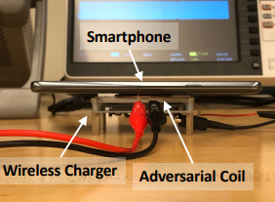
WPT Attack Vectors – Overview (1)
Hijacking
Injection of adversarial magnetic signals on the power transmitter to hijack the communication channel
Disruption of magnetic field (via well-crafted injection) between transmitter and receiver – cause inefficient power transfer
Control of power transfer process

Slide 7
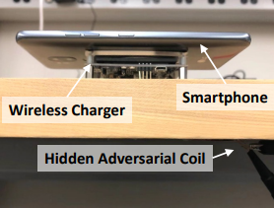
WPT Attack Vectors – Overview (2)
Eavesdropping
Qi has lack of encryption and authentication mechanisms
Snoop communication between transmitter and receiver
Infer activity of receiver device
Qi Sniffer allows basic device identification

Slide 8
Motivation
Wireless Power Transfer has become an industry standard being incorporated into more and more areas of technology
Personal Electronics, Healthcare Devices, Electric Vehicles
Exploit techniques and results found in this experiment can potentially be generalized
This research will create a foundation for further experimentation and TTP development
Findings expanded to other wireless non-networked point-to-point connections

Slide 9
Problem Statement
IDENTIFY
Vulnerabilities
How to exploit
How to defend
APPLY
Proof of concept – hijacking
Proof of concept – eavesdropping
Interpretation of results
EXPAND
Provide research to NRO
Observe various side channel-attacks
Create security mitigations – Software Based Encryption
Expand to larger technologies

Slide 10
Key Accomplishments to Date
Replicated Experiment
Wireless Charging Power Side-Channel Attacks
Demonstrated Injection
Demonstrated Snooping
Developed Demodulation Program
Researched various aspects of WPT and related attacks/mitigation
Signature Analysis
OS Interactions
Qi Sniffer
Fingerprinting (Script)
Encryption
Authored Research Paper

Slide 11
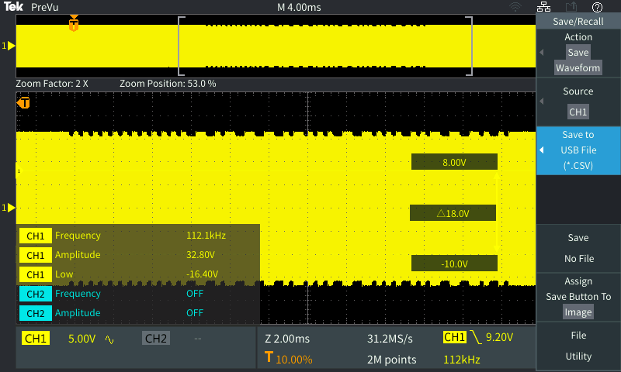
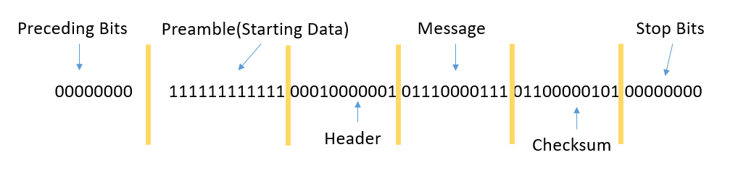
Packet Interception
Captured Signal
Captured Signal Demodulated
Signal Strength Status Update 1

Slide 12
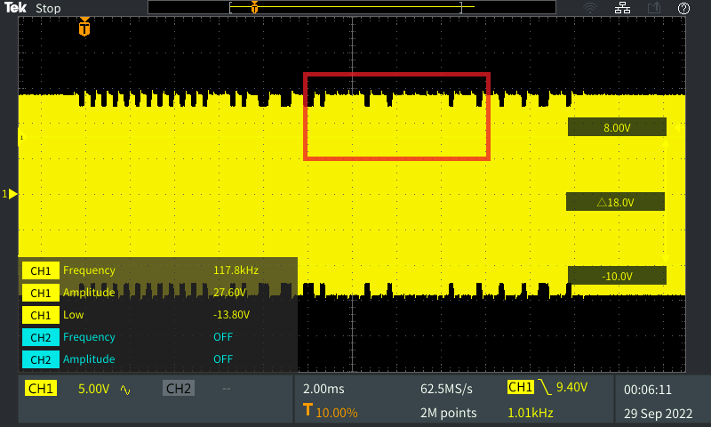
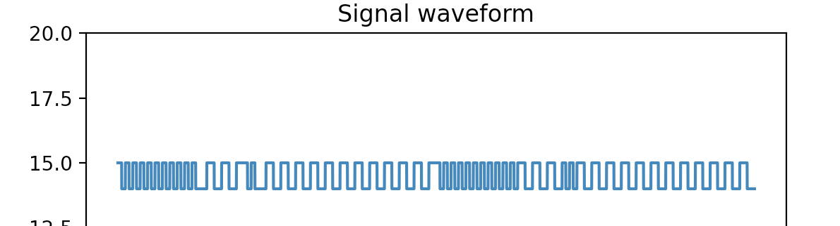
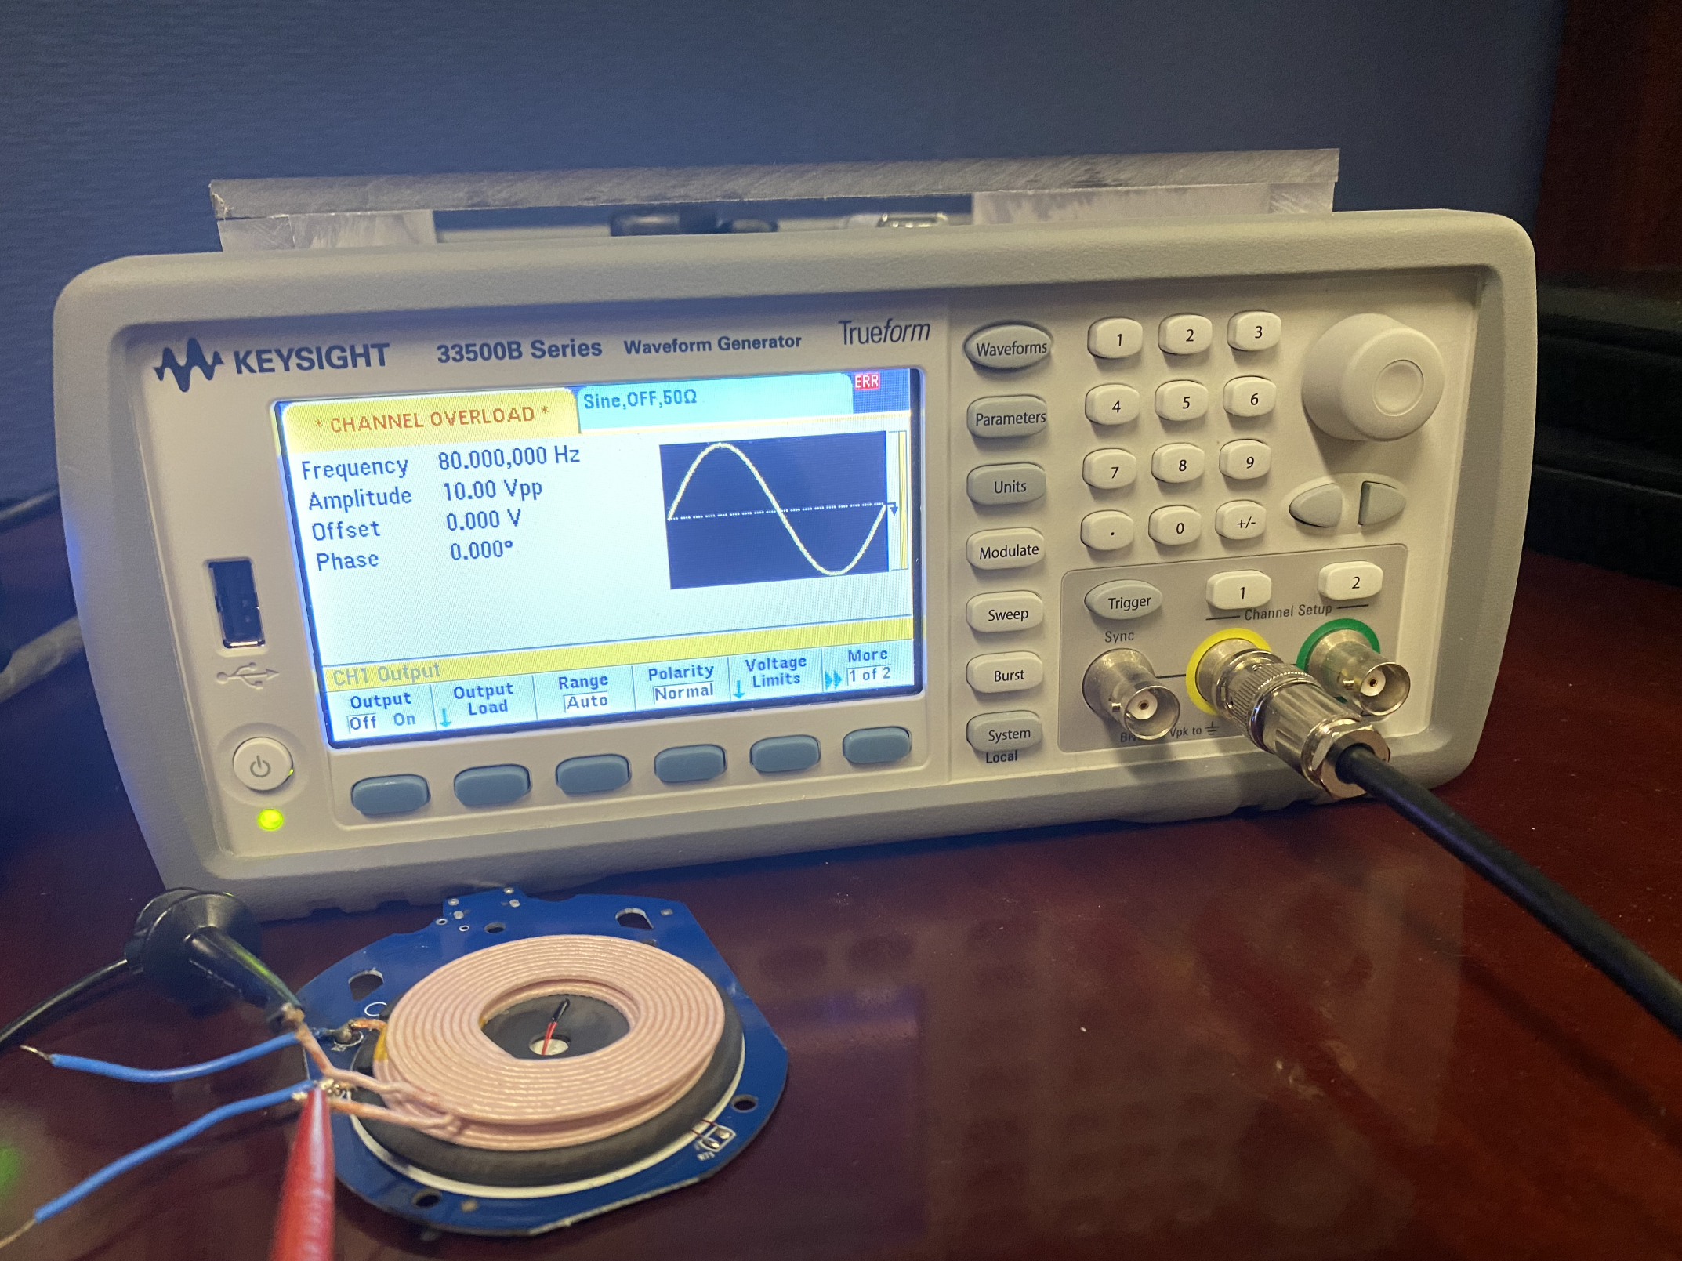
Packet Injection
Crafted Waveform Signal
Frequency: 80kHz
Amplitude: 10Vpp
Offset: 0V
Phase: 0V
Capable of 0101 injection
Injection Test 1
1 1 1 1 1 1 1 1 1 1 1 1 0 1 1 1 0 1 0 1 0 1 1 1 0 1 0 1 0 1 0 1 1 1 0 1 1 1 0 1 0 1 0 1 1
Channel Overload
(Magnetic Signal Interference)

Slide 13
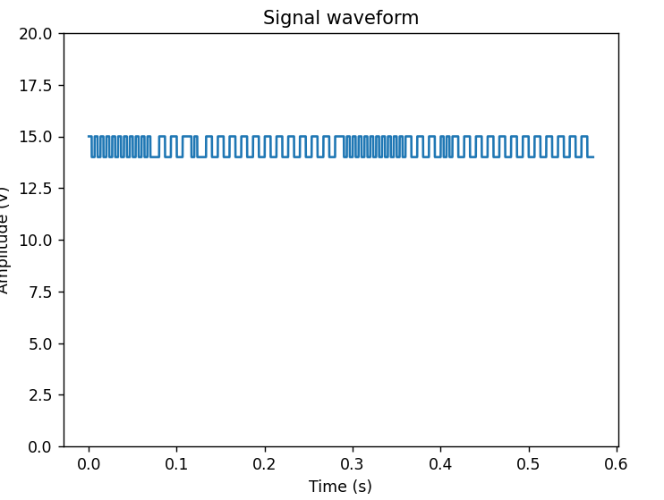
Scripted Packet Generation
Generates Qi Signal – Exported via output csv file
Converts binary data into modulated signal utilizing a user specified sampling rate and clock frequency
Two types of Packets
End Power Transfer (EPT) Control 1
Control Error (CE) Control 1
Stages
Preamble (Between 11 and 25 bits)
Header
Data Message
Checksum

Slide 14
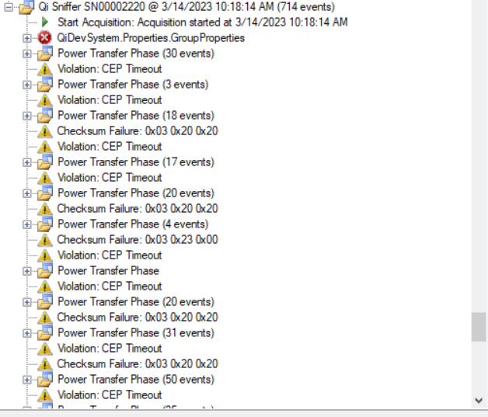
Injection Via Waveform Generator
Utilizes csv files to inject crafted signals
Capture interactions via qi sniffer
Demonstrated greater overlap with signal injection
Existing Challenge
timing and overlapping of signal messages
Outright injection vs message overlap

Slide 15
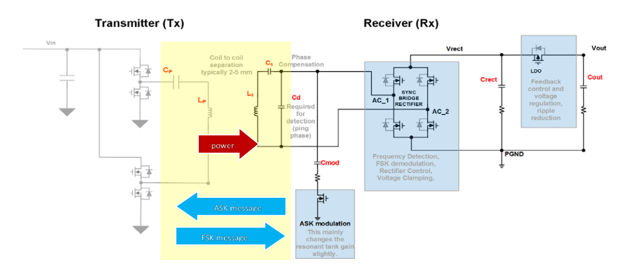
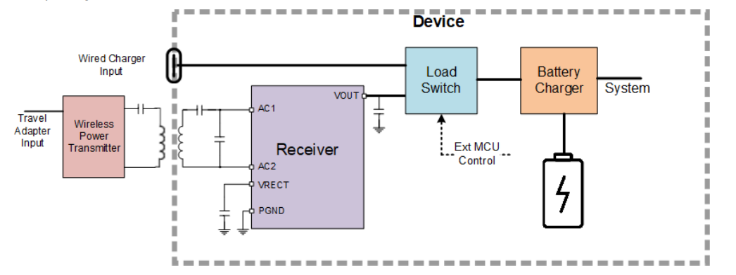
Qi Communication
The Rx monitors the battery and the charging process and uses ASK Modulation.
The Rx communicates at 2Kbs using a transistor array.
The Tx communicates at 200Bps using FSK modulation.

Slide 16
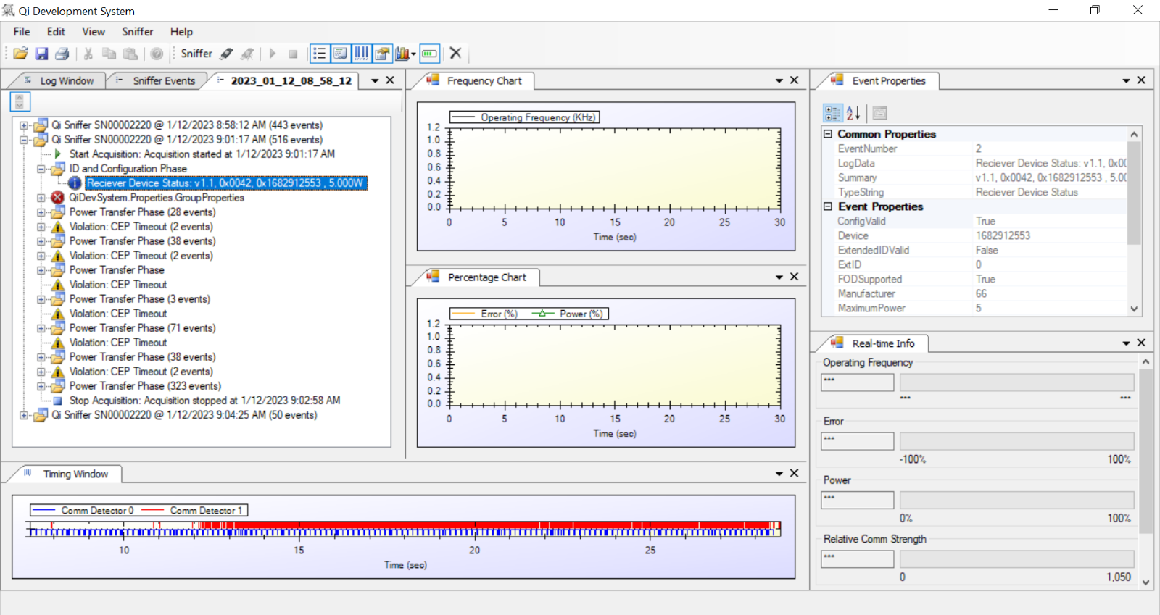
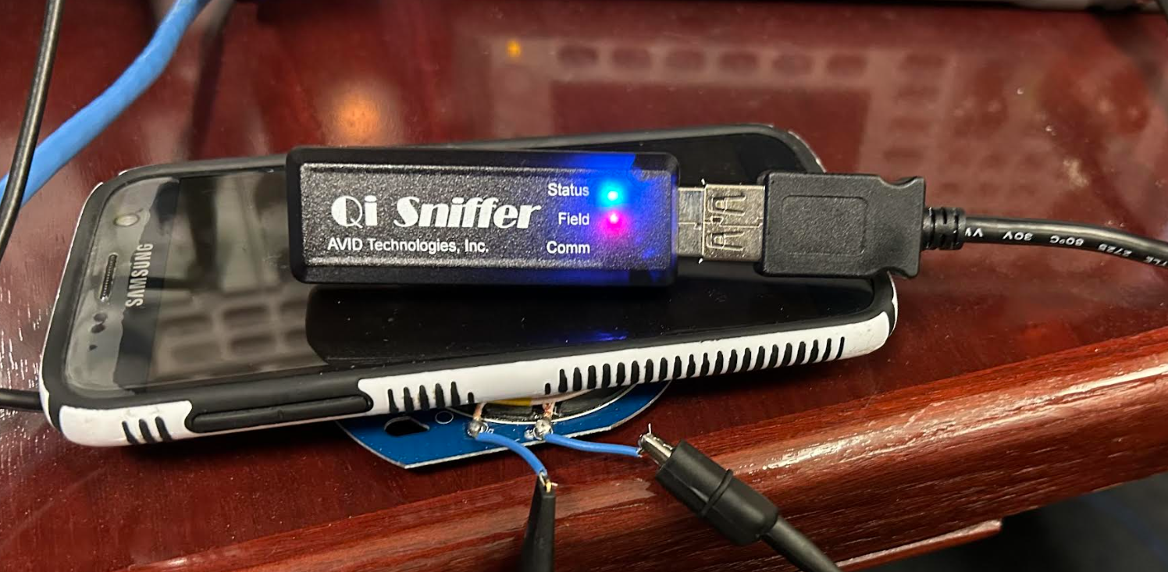
Qi Sniffer
Qi Development System
Sniffer Events, Event Properties, Timing Window

Slide 17
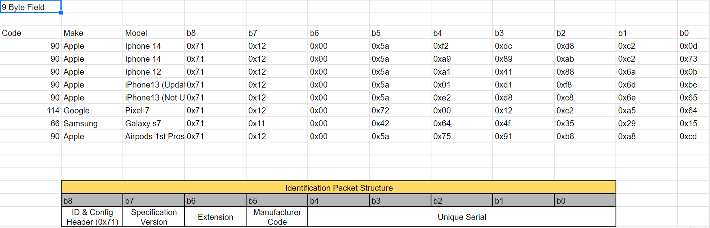
Fingerprinting
Qi sniffer provides important information for fingerprinting
Manufacturer
Unique Qi serial number
Charge status
Qi Version

Slide 18
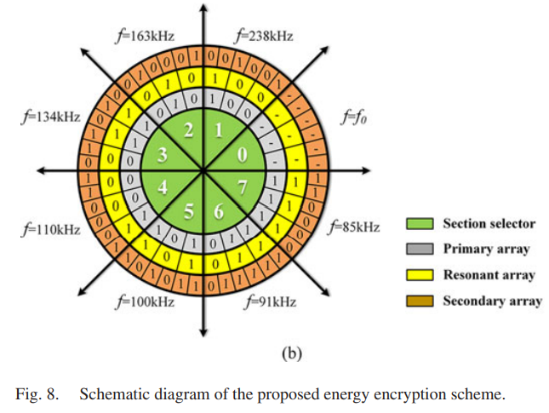
Software Based Encryption

Slide 19
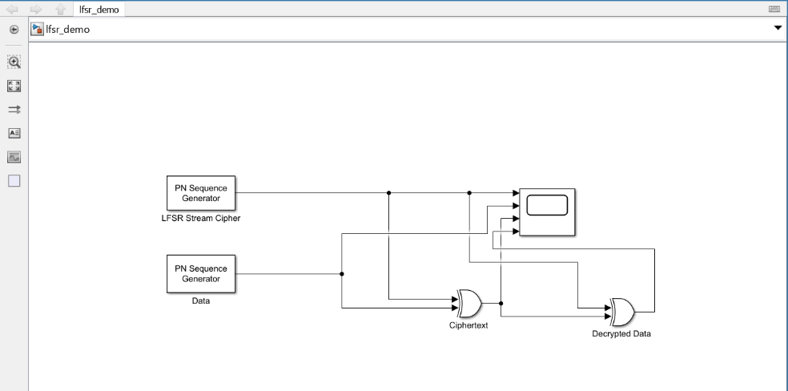
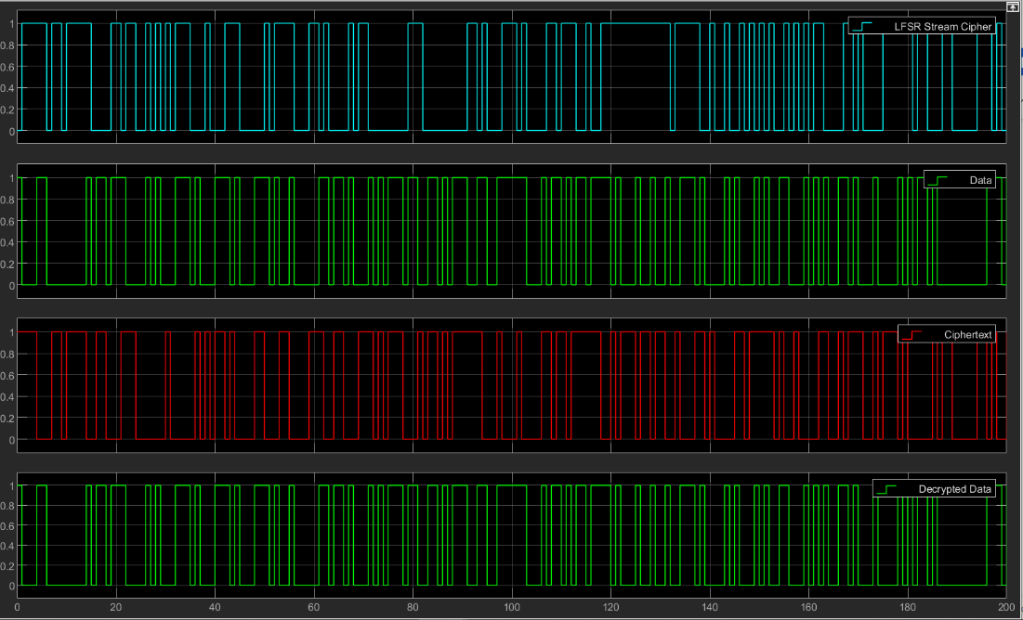
Linear Feedback Shift Register (LFSR) Encryption
LFSR is a stream cipher
Easily integrated into small devices
Basic level of encryption
Little to no effect on speed
Simulink Program created by Lt. Col McGinthy

Slide 20
Existing Challenges
ECE Injection Crafting
Overlap of injected and transmitted signal
Qi Simulation layered with Encryption
Collecting data from Qi Sniffer software and making it usable

Slide 21
Discussion of Progress and Implications
Based on research and testing findings, Qi is an unsecure standard
It is susceptible to multiple attack vectors (based on proof of concept)
It is open air and thus susceptible to snooping (based on proof of concept)
There are some available methods to attempt to alleviate these vulnerabilities
Encryption (based on proof of concept)
Other technologies/standards could be susceptible in the same ways
AirFuel, Proprietary Near Field Magnetic Coupling, RF, Ultrasound, EV Charging, Medical devices

Slide 22
Lessons Learned
Document, document, document
Overcomplicating the process with software can be detrimental to efficiency
Asking for help from the experts (or the tech support) is ok
Planning for research and software development are different
Some avenues explored will not work

Slide 23
Future Work
Work with ECE to brainstorm additional ways forward and new ways to approach
Lt Col Rogers
Improved signal injection
Injected signal is properly interpreted allowing for denial of charge or device overcharge
Development and testing of Qi Protection Mechanisms
Hardware or Software based cryptography
Injection/packet modification detection
Applications with laser-based point-to-point communication
Non-networked systems

Slide 24
Questions?

